Slide 1
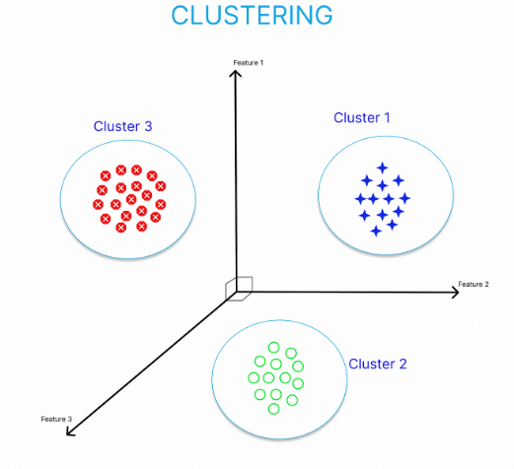
CREATING CLUSTERS ON GLOBAL DEVELOPMENT MEASUREMENT DATASET P302 : GROUP 3
MR.AGHIL MENON UDAYAKUMARAN
MR.SANTHOSHKUMAR
MS.RADHIKA ATRE
MR.DEVRAJ KADAM

Slide 2
INTRODUCTION TO CLUSTERING
It is basically a type of unsupervised learning model. Clustering is the task of dividing the population or data points into a number of groups such that data points in the same groups are more similar to other data points in the same group and dissimilar to the data points in other groups.

Slide 3
Project milestones :
Week 1 : EDA
Week 2 : Model Building
Week 3 : Model Evaluation
Week 4 : Deployment

Slide 4

Exploratory data analysis

Slide 5
EDA
Originally there were 2704 Rows and 25 Columns.
Checked data info .
Renamed the Columns.
Changed the data type from OBJECT to INT or FLOAT
Checked data duplicated if any.

Slide 6
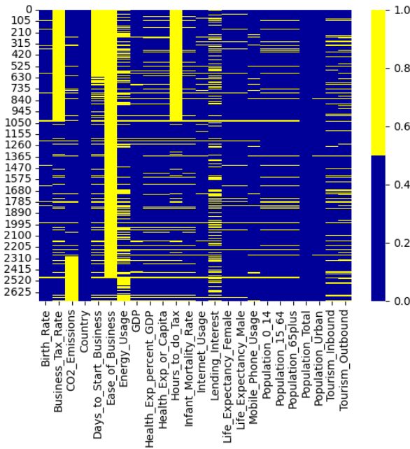
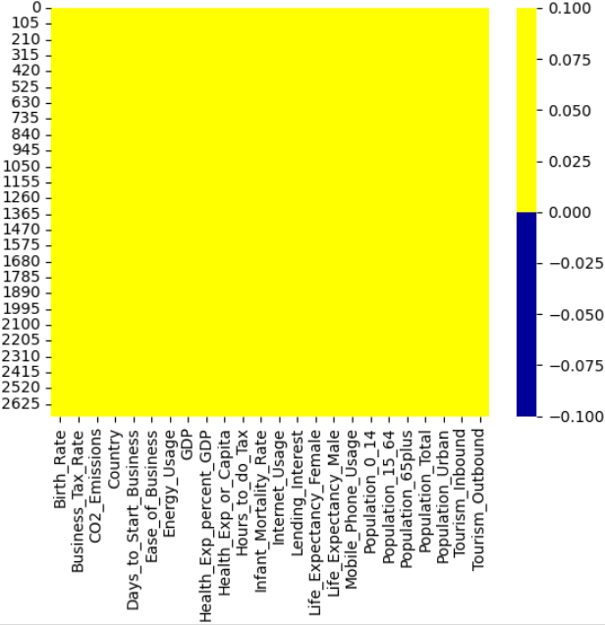
EDA
Null Values

Slide 7
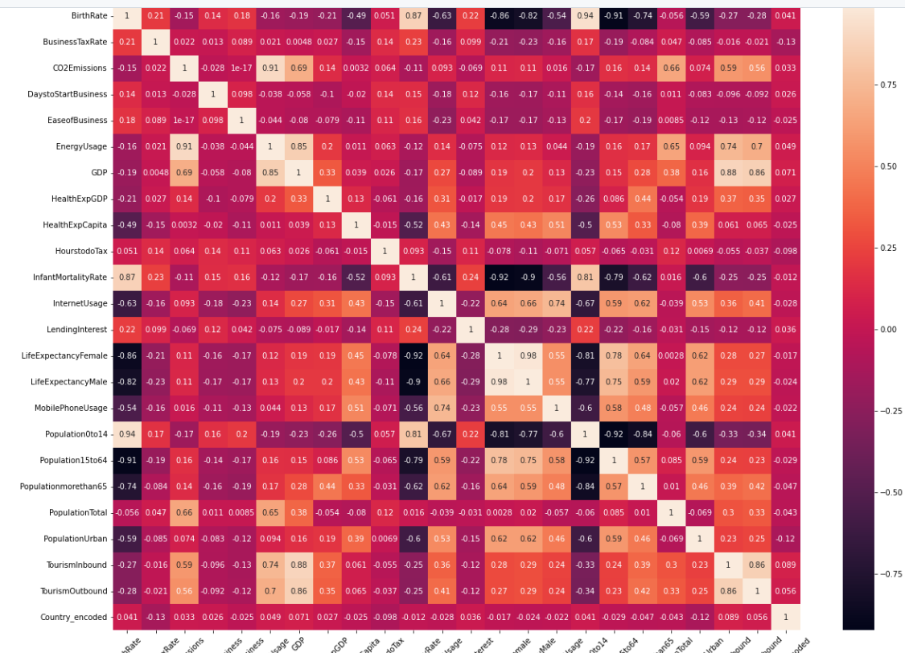
EDA
CORELATION ANALYSIS
‘Population 0 to 14’ & ‘Birth Rate’ has strong relation.
‘Population 15 to 64’ & ‘Birth Rate’ has weak relation.

Slide 8
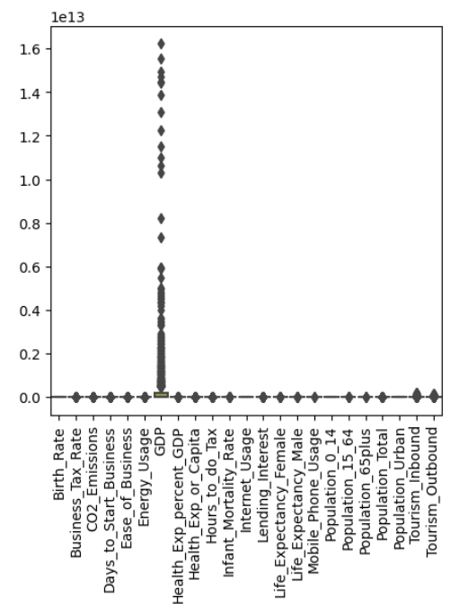
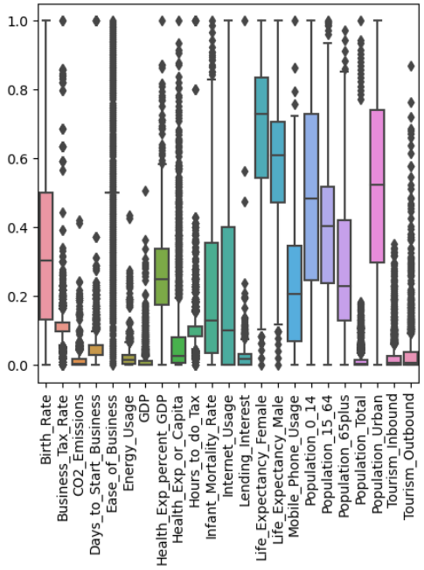
EDA
Outlier detection of Outliers after Using
Raw Data Isolation Forest

Slide 9
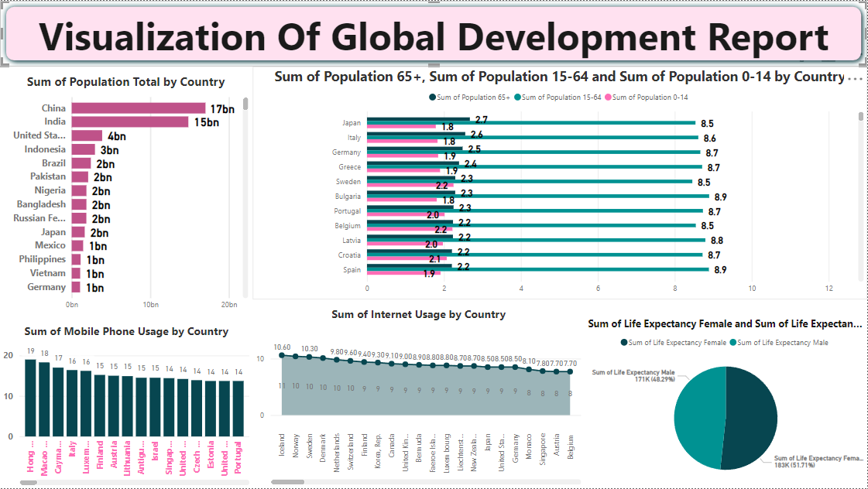

Slide 10
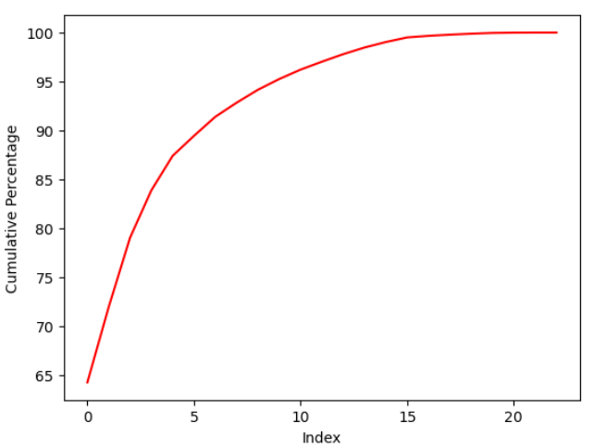
DiMENSIONALITY REDUCTION PCA
Variance Plot for PCA Components :

Slide 11
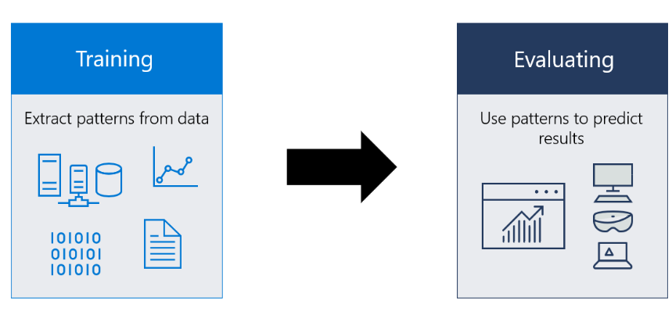
MODEL BUILDING

Slide 12
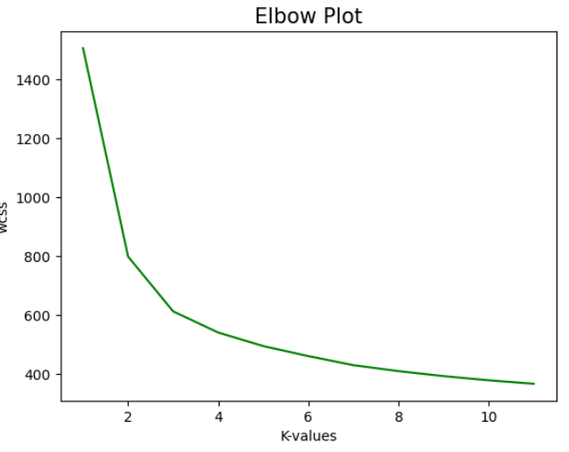
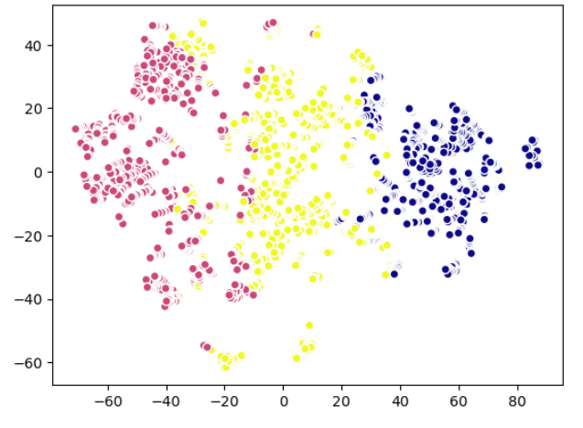
K-MEANS CLUSTERING :
As per the Elbow Plot, it is best to have 3 Clusters.
Silhouette score for k-means : 0.57165
K-means TSNE plot :

Slide 13
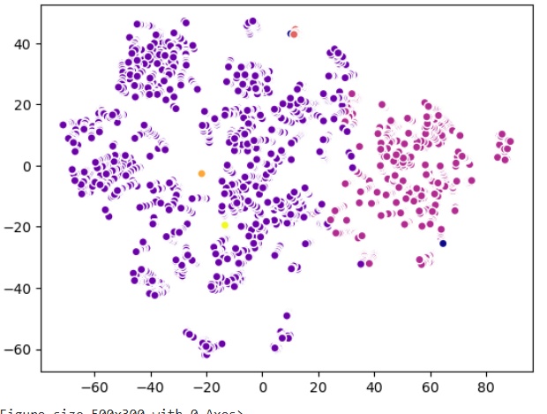
K-MEANS BASED ON PRACTICAL SITUATION
Building k-means model with n_clusters = 6 , random_state=42
(As per domain expert)
Silhouette score = 0.6125

Slide 14
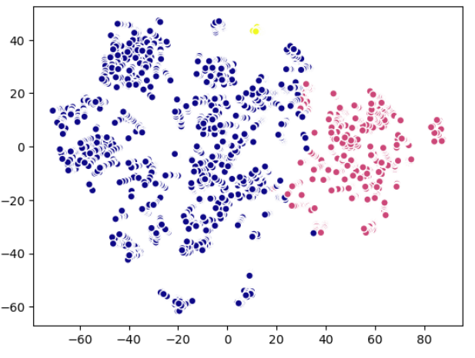
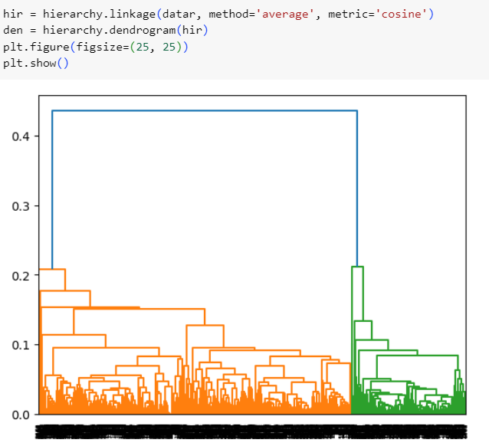
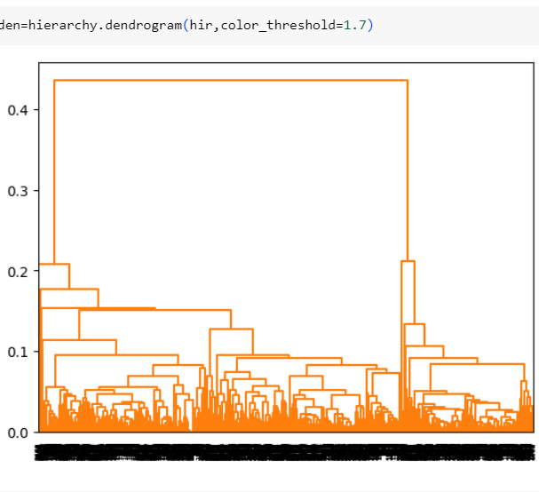
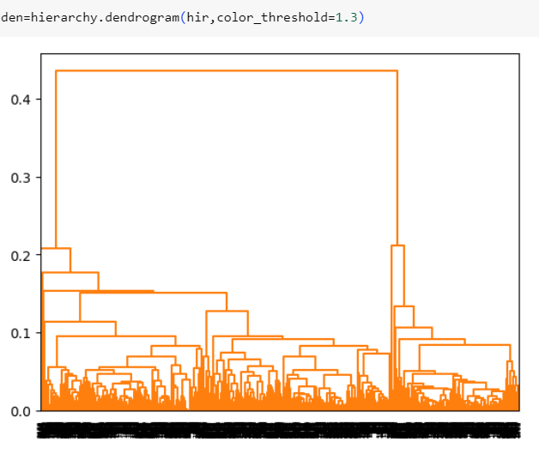
HIERARCHY AGGLOMERATIVE CLUSTERING

Slide 15
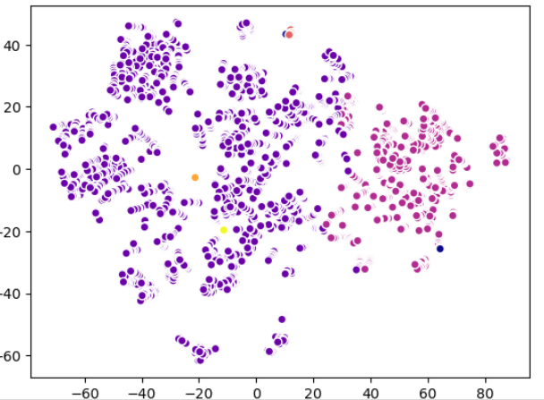
DBSCAN
Initially we have built a DBSCAN model with eps=0.5 & min_samples=5 .
Silhouette score for DBSCAN : 0.5385
DBSCAN TSNE:

Slide 16
SPLITTING THE DATA INTO TRAIN AND TEST
Shape of X_train = (2140, 23)
Shape of X_test = (536, 23)
Shape of Y_train = (2140, )
Shape of Y_test = (536, )

Slide 17
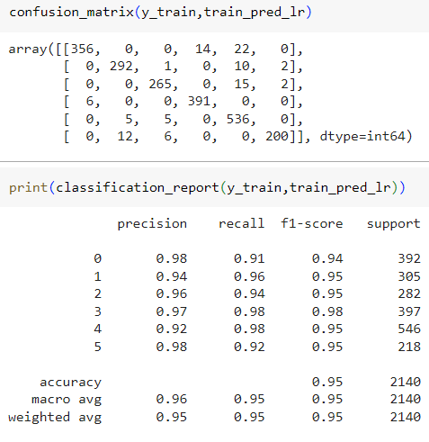
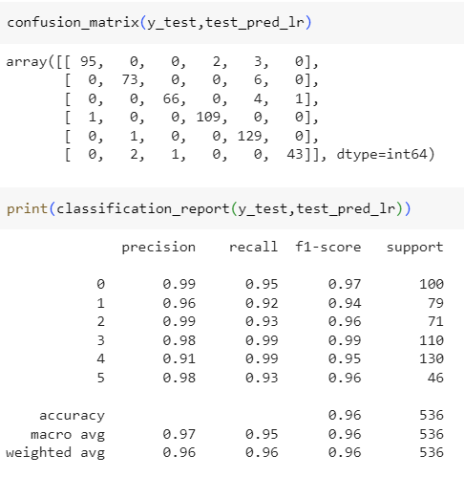
LOGISTIC REGRESSION
Confusion Matrix & Classification Report

Slide 18
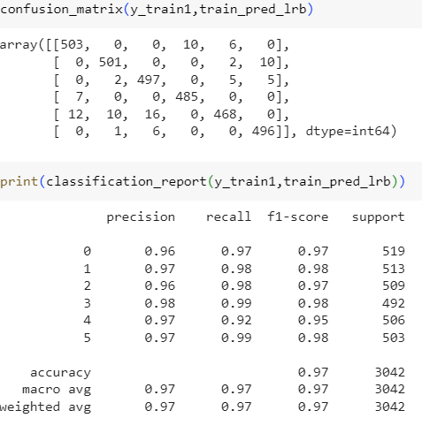
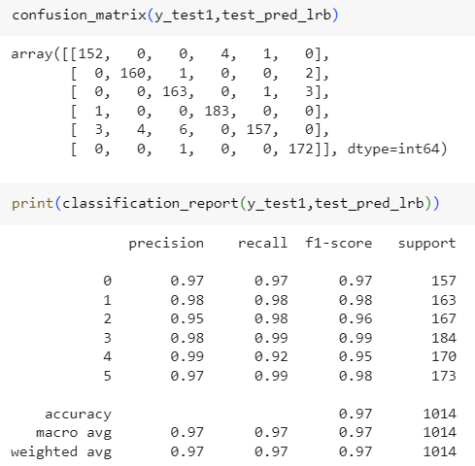
BALANCING THE DATA USING SMOTE
Shape of X_train : (3042, 23) Shape of Y_train : (3042, )
Shape of X_test : (1014, 23) Shape of Y_test : (1014, )
LOGISTIC REGRESSION AFTER BALANCING THE DATA
Confusion Matrix & Classification Report

Slide 19
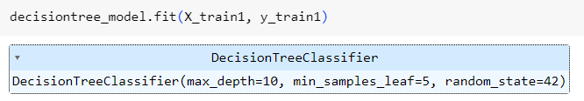
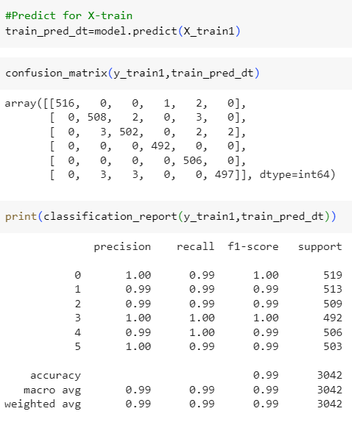
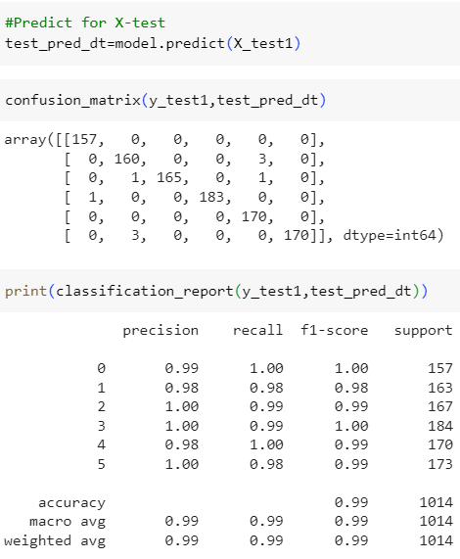
DECISION TREE
Building Decision Tree Classifier Model with best parameters we got from grid search
Confusion Matrix & Classification Report

Slide 20
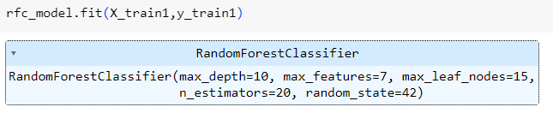
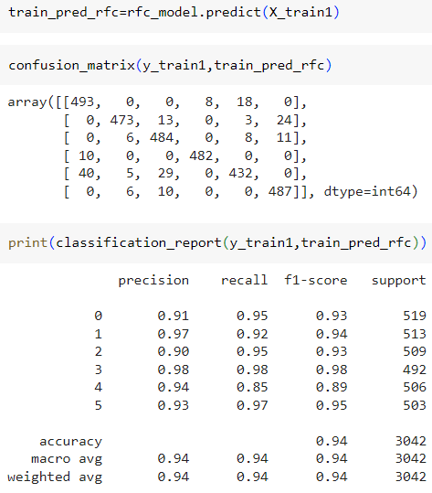
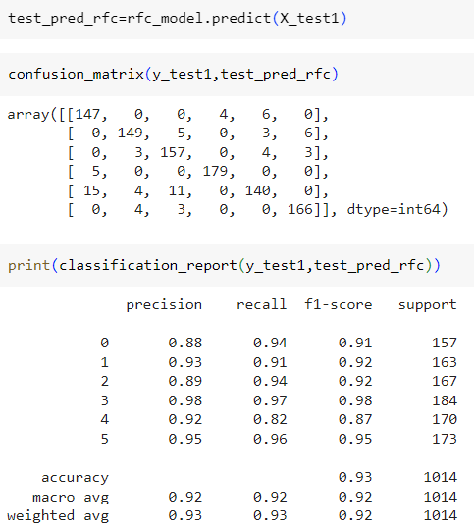
RANDOM FOREST CLASSIFIER
Building Random Forest Classifier Model with best parameters we got from grid search.
Confusion Matrix & Classification Report

Slide 21
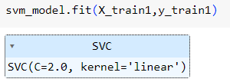
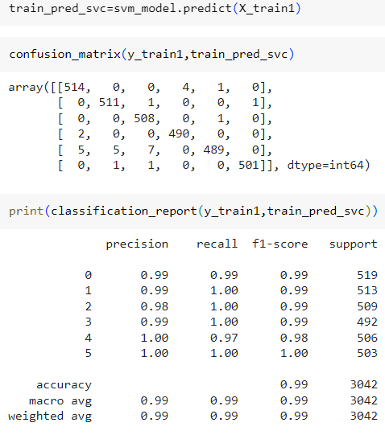
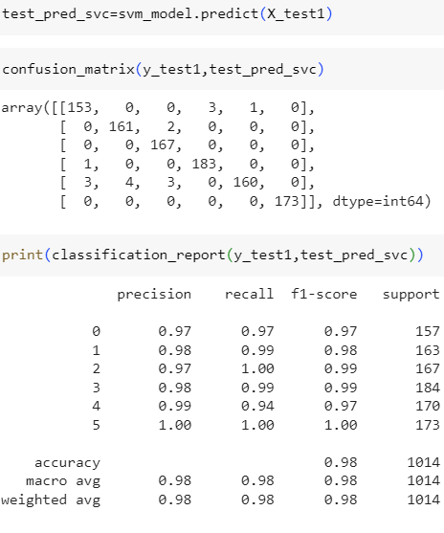
SUPPORT VECTOR MACHINE
Building SVM model with best parameters we got from grid search
Confusion Matrix & Classification Report

Slide 22
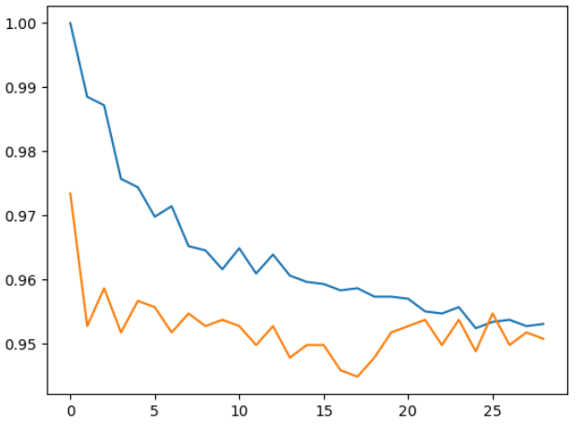
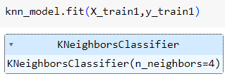
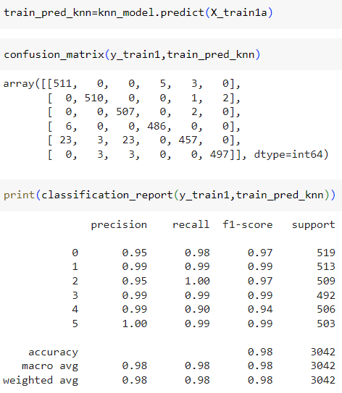
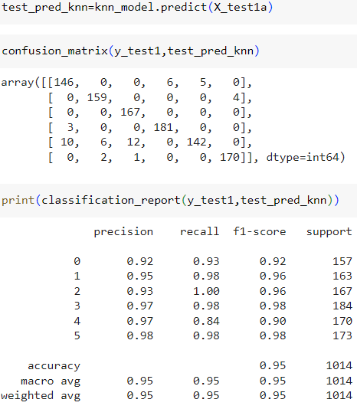
K-Nearest neighbor
Here k is near to 4.
Model Building
Confusion Matrix & Classification Report

Slide 23
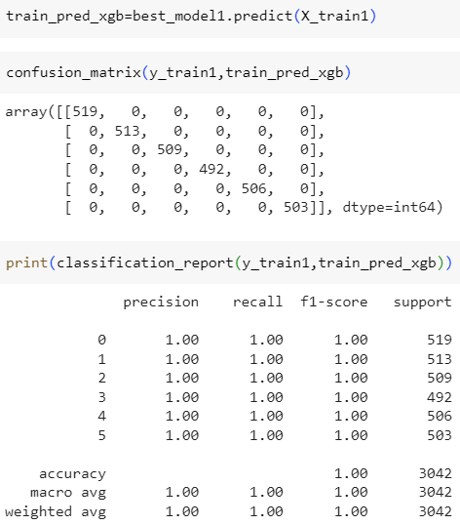
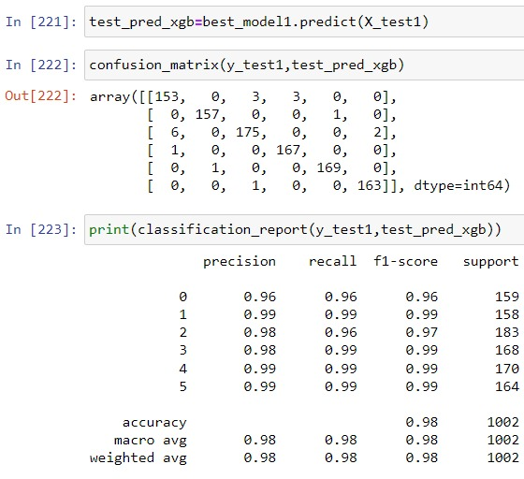
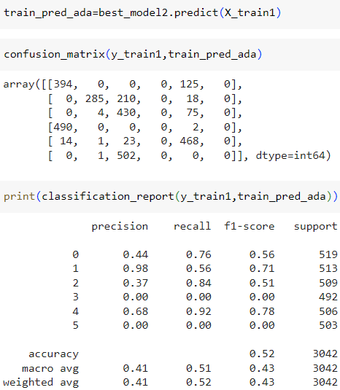
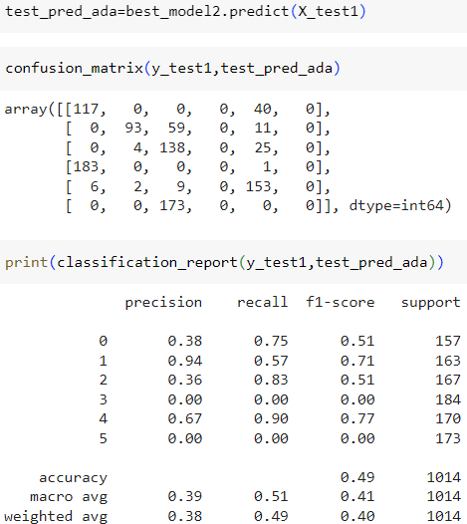
GRADIENT BOOSTING
XGBOOST : Confusion Matrix & Classification Report
ADABOOST : Confusion Matrix & Classification Report

Slide 24
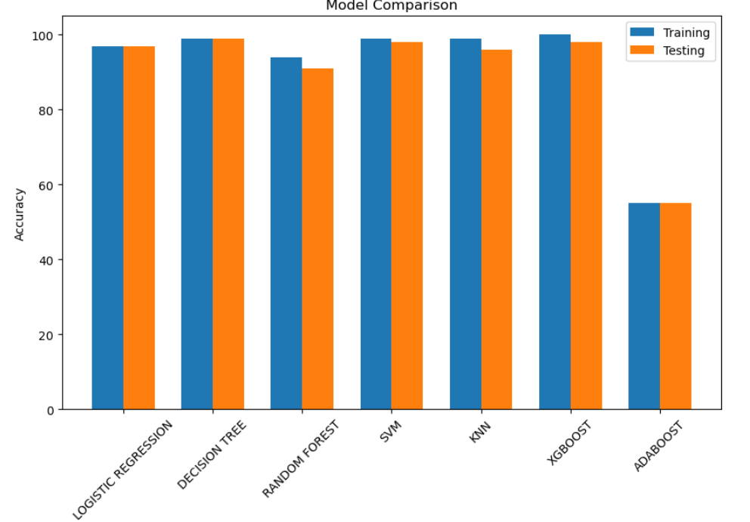
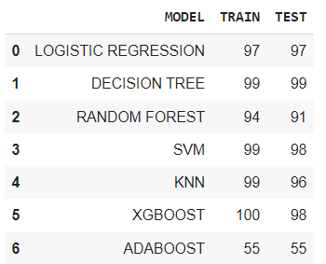
COMPARISION OF ALL MODELS
WE DECIDED TO CONTINUE WITH XGBOOST MODEL FOR DEPLOYMENT , AS IT IS GIVING HIGHER ACCURACY.

Slide 25
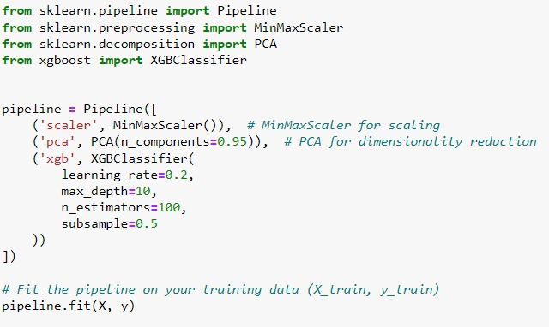
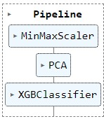
Creating pipe-line

Slide 26
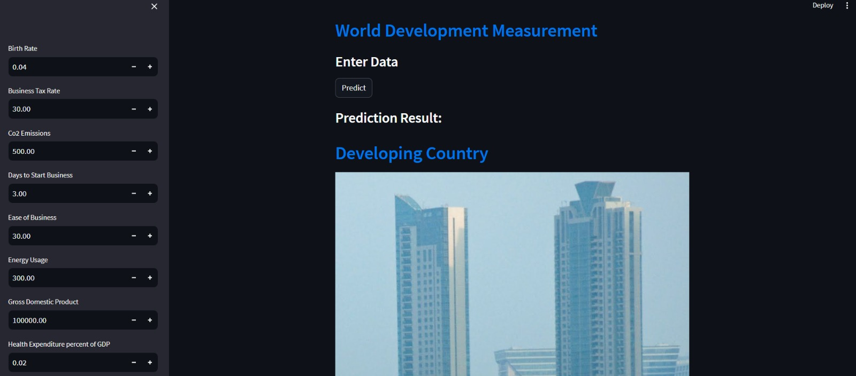
DEPLOYEMENT IN STREMLIT OUTPUT

Slide 27
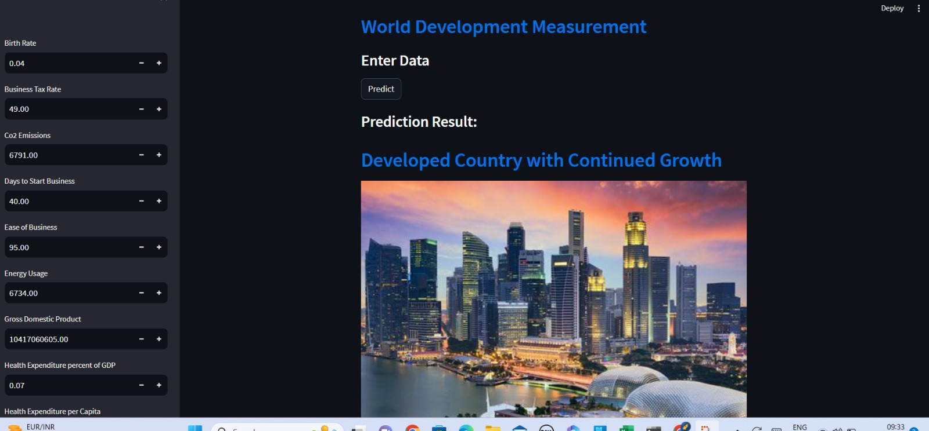

Slide 28
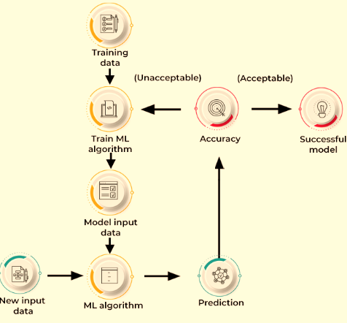
THANK YOU !

